Slide 1

職場故事 (Animaze 3D)
Notes:
Video by <a href="https://pixabay.com/users/mahdikalot-32457954/?utm_source=link-attribution&utm_medium=referral&utm_campaign=video&utm_content=146100">Mahdi Kalot</a> from <a href="https://pixabay.com//?utm_source=link-attribution&utm_medium=referral&utm_campaign=video&utm_content=146100">Pixabay</a>

Slide 2

1.目標
Notes:
Video by <a href="https://pixabay.com/users/moos-media-615889/?utm_source=link-attribution&utm_medium=referral&utm_campaign=video&utm_content=19512">Lukas Moos</a> from <a href="https://pixabay.com//?utm_source=link-attribution&utm_medium=referral&utm_campaign=video&utm_content=19512">Pixabay</a>

Slide 3
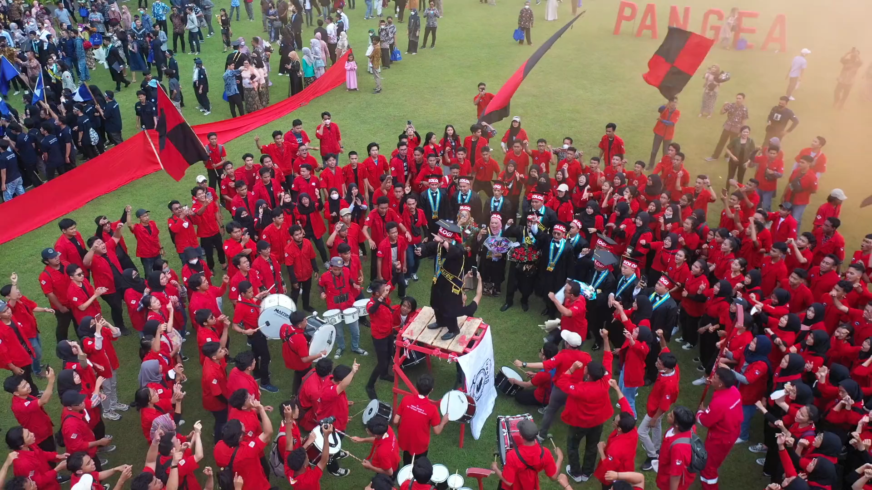
Notes:
Video by <a href="https://pixabay.com/users/u_97ubuhmwi1-32962663/?utm_source=link-attribution&utm_medium=referral&utm_campaign=video&utm_content=147133">u_97ubuhmwi1</a> from <a href="https://pixabay.com//?utm_source=link-attribution&utm_medium=referral&utm_campaign=video&utm_content=147133">Pixabay</a>
剛從大學畢業，我渴望成為一名軟體工程師，在一家科技公司迅速累積專業經驗。

Slide 4

Notes:
Video by <a href="https://pixabay.com/users/λζξ-3271136/?utm_source=link-attribution&utm_medium=referral&utm_campaign=video&utm_content=5709">Anand KZ</a> from <a href="https://pixabay.com//?utm_source=link-attribution&utm_medium=referral&utm_campaign=video&utm_content=5709">Pixabay</a>
我夢想著能參與那些能改變人們生活的重大專案，並希望在五年內晉升為技術領導，帶領團隊攻克技術難題。

Slide 5

2.阻礙
Notes:
Video by <a href="https://pixabay.com/users/geralt-9301/?utm_source=link-attribution&utm_medium=referral&utm_campaign=video&utm_content=546">Gerd Altmann</a> from <a href="https://pixabay.com//?utm_source=link-attribution&utm_medium=referral&utm_campaign=video&utm_content=546">Pixabay</a>
然而，畢業後的求職之路遠比想像中艱難，我連續投出多份履歷，卻很少收到回覆，只有寥寥幾家公司願意給我面試機會。

Slide 6

Notes:
Video by <a href="https://pixabay.com/users/curious_collectibles-11004713/?utm_source=link-attribution&utm_medium=referral&utm_campaign=video&utm_content=59686">Shaun</a> from <a href="https://pixabay.com//?utm_source=link-attribution&utm_medium=referral&utm_campaign=video&utm_content=59686">Pixabay</a>
面試結束後，得到的反饋大多是我缺乏實戰經驗，無法勝任公司需要的高難度專案，這讓我感到深深的挫敗和不安。

Slide 7

3.努力
Notes:
Video by <a href="https://pixabay.com/users/alexkopeykin-6178059/?utm_source=link-attribution&utm_medium=referral&utm_campaign=video&utm_content=40816">Олександр Копєйкін</a> from <a href="https://pixabay.com//?utm_source=link-attribution&utm_medium=referral&utm_campaign=video&utm_content=40816">Pixabay</a>
我不甘心被困在原地，決定全力以赴提升自己。

Slide 8

Notes:
Video by <a href="https://pixabay.com/users/coverr-free-footage-1281706/?utm_source=link-attribution&utm_medium=referral&utm_campaign=video&utm_content=1028">Coverr-Free-Footage</a> from <a href="https://pixabay.com//?utm_source=link-attribution&utm_medium=referral&utm_campaign=video&utm_content=1028">Pixabay</a>
我報名參加了一系列線上課程，學習熱門技術，同時，我也積極參與開源專案，並實際上手更多技術細節。除了技術的強化，我還尋求前輩的建議，調整自己的面試策略，並不斷練習

Slide 9
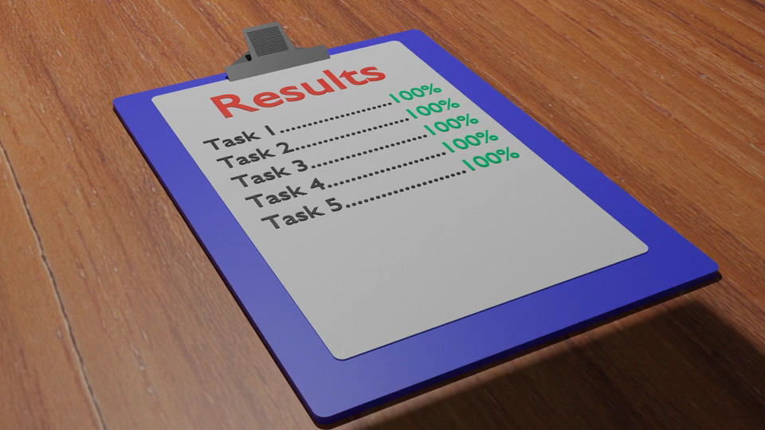
4.結果
Notes:
Video by <a href="https://pixabay.com/users/grantmuller-4619676/?utm_source=link-attribution&utm_medium=referral&utm_campaign=video&utm_content=133176">Grant Muller</a> from <a href="https://pixabay.com//?utm_source=link-attribution&utm_medium=referral&utm_campaign=video&utm_content=133176">Pixabay</a>
經過數月的努力，我終於成功接到一家科技新創公司的錄用通知，擔任初級軟體工程師。

Slide 10

Notes:
Video by <a href="https://pixabay.com/users/athree23-6195572/?utm_source=link-attribution&utm_medium=referral&utm_campaign=video&utm_content=18437">Adrian</a> from <a href="https://pixabay.com//?utm_source=link-attribution&utm_medium=referral&utm_campaign=video&utm_content=18437">Pixabay</a>
管公司規模不大，但專注於前沿技術的研發，我感覺自己終於踏上了夢寐以求的職業道路，未來充滿了無限可能。

Slide 11

5.意外
Notes:
Video by <a href="https://pixabay.com/users/thomas_ritter-4163713/?utm_source=link-attribution&utm_medium=referral&utm_campaign=video&utm_content=7013">Thomas Ritter</a> from <a href="https://pixabay.com//?utm_source=link-attribution&utm_medium=referral&utm_campaign=video&utm_content=7013">Pixabay</a>
然而，入職後我很快發現，現實與理想相距甚遠。

Slide 12

Notes:
Video by <a href="https://pixabay.com/users/piyapong89-7158719/?utm_source=link-attribution&utm_medium=referral&utm_campaign=video&utm_content=129427">Piyapong Saydaung</a> from <a href="https://pixabay.com//?utm_source=link-attribution&utm_medium=referral&utm_campaign=video&utm_content=129427">Pixabay</a>
公司專案的節奏非常快，而我被分配負責的模塊更是核心部分，技術難度大大超出我過去的經驗範圍，讓我一度陷入焦慮和自我懷疑中，擔心自己會拖垮整個團隊的進度。

Slide 13
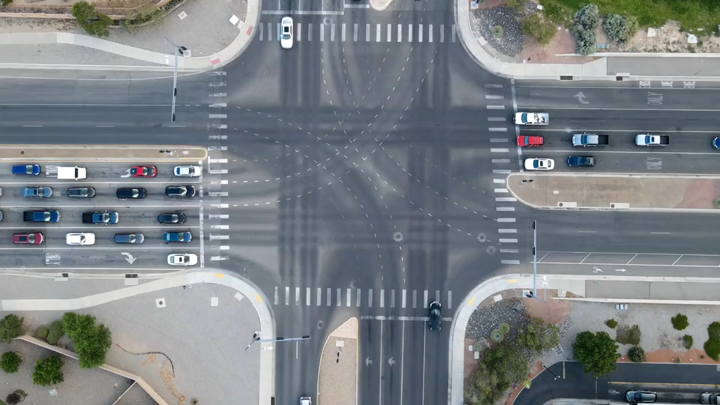
6.轉彎
Notes:
Video by <a href="https://pixabay.com/users/geraldmullins-15688070/?utm_source=link-attribution&utm_medium=referral&utm_campaign=video&utm_content=97885">Gerald Mullins</a> from <a href="https://pixabay.com//?utm_source=link-attribution&utm_medium=referral&utm_campaign=video&utm_content=97885">Pixabay</a>
就在我不知所措的時候，我的主管注意到了我的困境，主動與我談話，給予了我鼓勵。

Slide 14
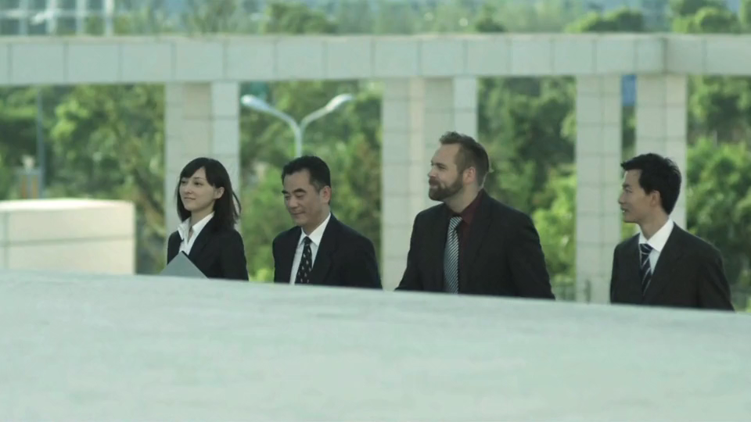
Notes:
Video by <a href="https://pixabay.com/users/huchideng0769-17752754/?utm_source=link-attribution&utm_medium=referral&utm_campaign=video&utm_content=46285">chideng hu</a> from <a href="https://pixabay.com//?utm_source=link-attribution&utm_medium=referral&utm_campaign=video&utm_content=46285">Pixabay</a>
他安排了一位資深工程師來協助我，我們一起討論解決方案，拆解問題，並且他教會我如何以更有效率的方式應對技術挑戰。通過這次合作，我逐漸掌握了模塊的開發重點，也體會到在高壓環境下，團隊合作的重要性。

Slide 15

7.結局
Notes:
Video by <a href="https://pixabay.com/users/λζξ-3271136/?utm_source=link-attribution&utm_medium=referral&utm_campaign=video&utm_content=5709">Anand KZ</a> from <a href="https://pixabay.com//?utm_source=link-attribution&utm_medium=referral&utm_campaign=video&utm_content=5709">Pixabay</a>
最終，我們成功按時交付了專案，並且獲得了客戶的高度讚賞。

Slide 16

Notes:
Video by <a href="https://pixabay.com/users/engin_akyurt-3656355/?utm_source=link-attribution&utm_medium=referral&utm_campaign=video&utm_content=44639">Engin Akyurt</a> from <a href="https://pixabay.com//?utm_source=link-attribution&utm_medium=referral&utm_campaign=video&utm_content=44639">Pixabay</a>
這次經歷讓我深刻體會到，除了個人的技術提升外，懂得依賴團隊、善用資源，才能真正應對職場中的各種挑戰，這也讓我對未來的職業發展更有信心。

